Slide 1
SYNTHESIS AND CHARACTERIZATION OF POLYACRYLONITRILE (PAN) AND CARBON FIBERS
ALOK KUMAR
Presenter

Slide 2
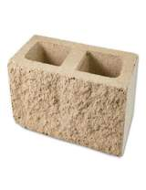
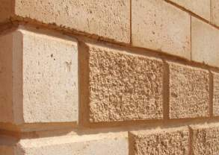
POLYMER
THE SCIENCE AND ENGINEERING OF LARGE MOLECULES
Long chain molecules
long molecule made up by the repetition of small unit called monomers BUILDIGNG BLOCK

Slide 3
POLYMER CLASSES
Polymers
Inorganic
Organic
Natural
Clays, Sands, Glass, Rock-like, Ceramics, Graphite/Diamond, Silicas
Organic/Inorganic
Siloxane, Polyphosphazenes, Polyphosphate esters, Polysilanes, Sol-gel network
Natural
Proteins, Nucleic acids, Lignins, Polysccharides, Polyisoprene, Melanin
Synthetic
Fibrous glass, Silicon Carbide, Poly(boron nitrid), Poly(sulfur nitride)
Synthetic
PE, PS, Nylons, PET, PVC, PU, PC, PMMA, PVAC, PP, PTFE

Slide 4
POLYMER
-A-A-A-A-A-A-A-A- Homo Polymer
-A-B-B-A-B-A-A-B- Random Copolymer
-A-B-A-B-A-B-A-B- Alternating Copolymer
-A-A-A-A-B-B-B-B- Block Copolymer
-A-A-A-A-A-A-A-A- Graft Copolymer
B-B-B-B-B-B-

Slide 5
POLYACRYLONITRILE (PAN)

Slide 6
IMPORTANCE OF PAN
Homo polymers of Polyacrylonitrile have been used as
Fibers in hot gas filtration systems
Outdoor awnings
Sails for yachts
Fiber reinforced concrete
Mostly copolymers containing Polyacrylonitrile are used as
Fibers to make knitted clothing, like socks and sweaters
Outdoor products like tents

Slide 7
POLYACRYLONITRILE (PAN)
In 1893 Acrylonitrile was prepared by reacting Propylene with Ammonia (NH₃) and oxygen in the presence of catalysts.
PAN is a vinyl polymer and a derivative of the acrylate family of polymers.
It is made from acrylonitrile monomer through suspension methods using free-radical initiators.

Slide 8
POLYACRYLONITRILE (PAN)

Slide 9
PAN LAB SYNTHESIS
Polymerization of acrylonitrile (AN) by redox method
Flask or lab reactor
Nitrogen atmosphere
Fitted with a condenser
Reaction medium (Dimethylsulfoxide (DMSO) solvent or water)

Slide 10
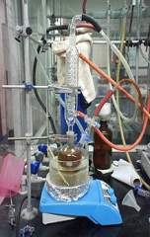
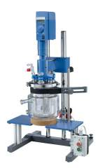
PAN LAB SYNTHESIS
Emulsifier ( e.g Sodium bisulfite (SBS) )
Initiators ( e.g Potassium Persulfate (KPS), Azodiisobutyronitrile (AIBN), Itaconic acid (IA) )
Time 1–3.5 hr
Precipitation
Filtration
Washing ( methanol and deionized water etc)
Drying under vacuum till a constant weight

Slide 11
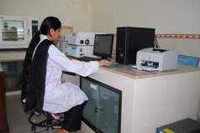
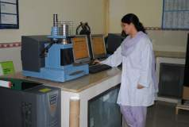
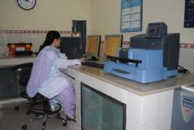
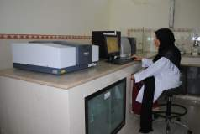
PAN CHARACTERIZATION
FTIR (Fourier Transform Infrared Spectrophotometer)
NMR (Neutron Magnetic Resonance)
GPC (Gel Permeation Chromatograph)
DSC (Differential Scanning Calorimeter)
TGA (Thermo Gravimetric Analyzer)
TMA (Thermo Mechanical Analyzer)

Slide 12
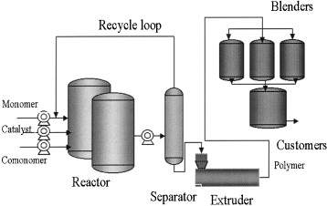
PAN INDUSTRIAL PRODUCTION

Slide 13
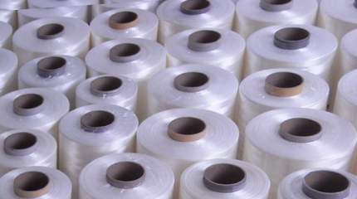
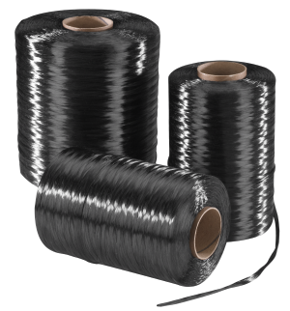
PAN FIBER & CARBON FIBER

Slide 14
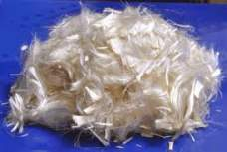
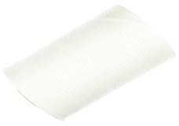
IMPORTANCE OF PAN FIBER
PAN-based fibers eventually supplanted most rayon-based fibers, and they still dominate the world market. In addition to high modulus fibers, researchers have also developed a low modulus fiber from PAN that had extremely high tensile strength. Used in
Sporting goods such as golf clubs, tennis rackets, fishing rods, and skis
Military
Commercial aircrafts

Slide 15
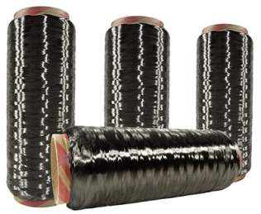
IMPORTANCE OF CARBON FIBER
Strength: carbon fibers tensile strength is un-matched by any metal available (Titanium alloys, Cr Mo, steel or Aluminum alloys)
Weight: carbon fiber/epoxy weight per volume is less than half that of aluminum almost 4 times lighter than titanium
Fatigue resistance of carbon fiber surpasses that of any other structural material

Slide 16
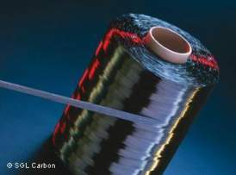
IMPORTANCE OF CARBON FIBER
Yield strength: carbon fiber has a very high yield strength allowing it to flex under extreme loading and return to its original shape
Corrosion: carbon fiber/epoxy is extremely resistant to corrosion

Slide 17
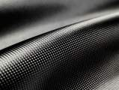
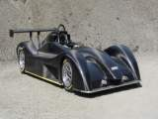
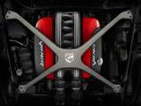
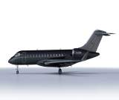
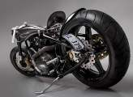
IMPORTANCE OF CARBON FIBER
Carbon fiber parts will be lighter and stronger. Because of such properties you find this technology used in
Aviation
Sports
High-end racing and
Snowmobiles

Slide 18
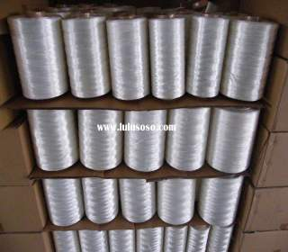
CARBON FIBER
Carbon fibers are derived from one of the three precursor materials
PAN (Polyacrylonitrile fiber)
PITCH
Isotropic
Mesophase
Rayon

Slide 19
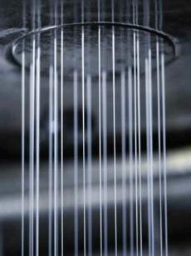
PAN FIBER INDUSTRIAL PRODUCTION
Melt Spinning
Dry Spinning
Wet Spinning
Wet/Dry Spinning

Slide 20
PAN FIBER FORMATION
Polyacrylonitrile fibers were produced by wet-spinning.
The coagulation bath is normally
DMSO/H₂O system,
Bath temperature is 60°C
Bath concentration is 65% (namely, DMSO/H₂O=65/35(wt/wt))
Bath minus stretch ratio is –10%

Slide 21
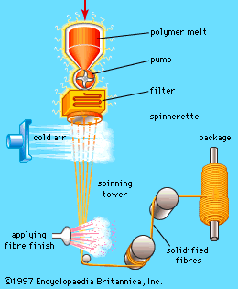
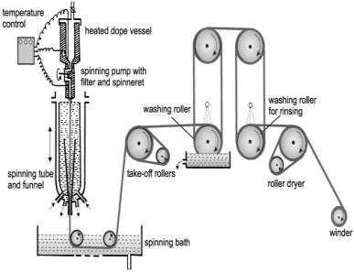
PAN FIBER INDUSTRIAL PRODUCTION

Slide 22
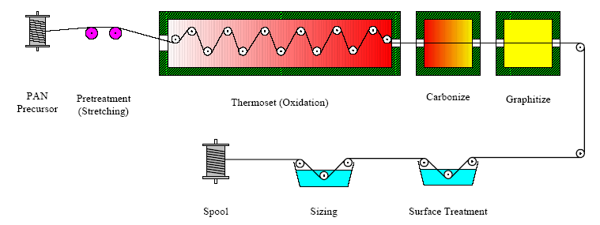
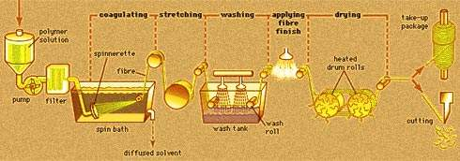
PAN FIBER INDUSTRIAL PRODUCTION

Slide 23
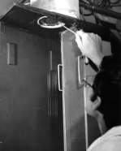
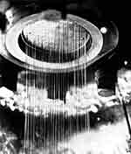
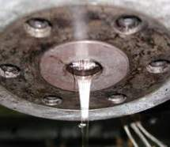
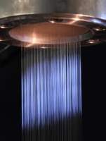
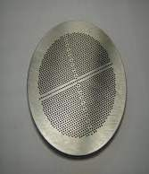
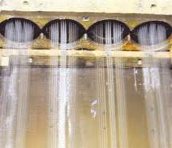
PAN FIBER INDUSTRIAL PRODUCTION

Slide 24
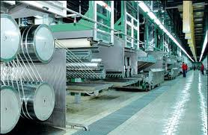
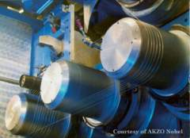
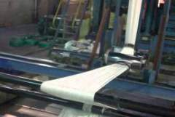
PAN FIBER INDUSTRIAL PRODUCTION

Slide 25
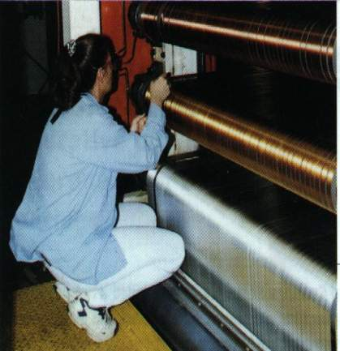
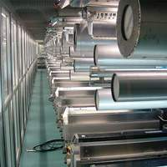
CARBON FIBER FORMATION
Fiber changing color. The white PAN strands at the bottom pass through the air heated oven and begin to darken. Quite quickly they turn to black

Slide 26
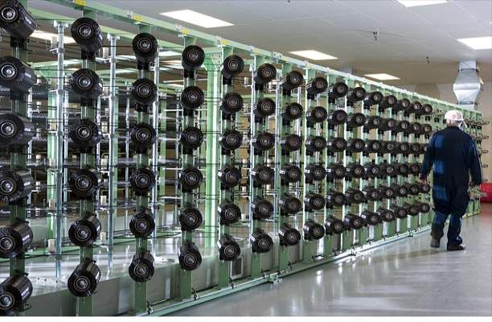
CARBON FIBER INDUSTRIAL PRODUCTION

Slide 27
PAN FIBER INDUSTRIAL FORMATION
Oxidization
Stress graphitization of Polyacrylonitrile based carbon fiber
Carbonization (graphitization)

Slide 28
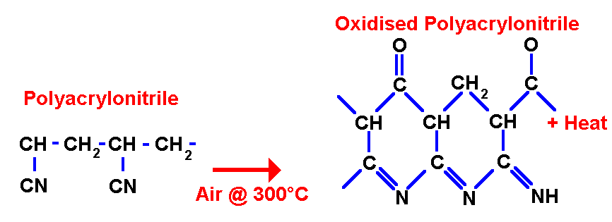
PAN FIBER INDUSTRIAL FORMATION
Oxidization
This produces an oxidized ladder polymer structure approximately parallel to the fiber axis which may be regarded as the template for the formation of the oriented carbon fiber.
Oxidation involves heating the fibers to around 300 ºC in air. This evolves hydrogen from the fibers and adds less volatile oxygen.
The polymer changes from a ladder to a stable ring structure, and the fiber changes color from white though brown to black.

Slide 29
CARBON FIBER INDUSTRIAL PRODUCTION
Stress Graphitization of Polyacrylonitrile Based Carbon Fiber
Carbon fiber can be made by the pyrolysis of organic polymer fiber precursors. The strength of PAN carbon fiber declines when heated above 1,200° C.
Therefore increasing strength with Young's modulus can be obtained if stress is applied to the fiber at graphitizing temperatures.

Slide 30
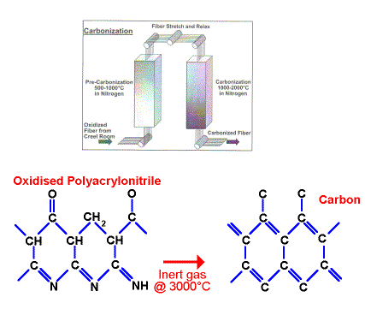
CARBON FIBER INDUSTRIAL PRODUCTION
CARBONIZATION (GRAPHITIZATION)
Involves heating the fibers up to 3000 ºC in an inert atmosphere.
Fibers are now nearly 100 % carbon

Slide 31
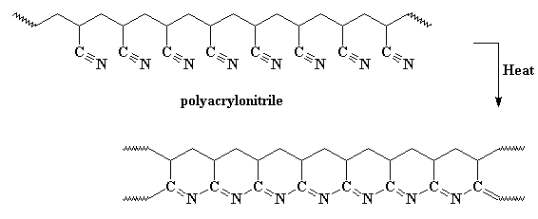
CARBON FIBER FORMATION CHEMISTRY
When we heat Polyacrylonitrile, the heat causes the cyano repeat units to form cycles…

Slide 32
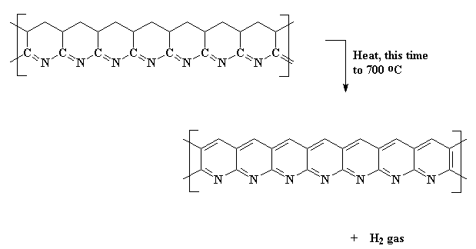
CARBON FIBER FORMATION CHEMISTRY
At higher temperature, carbon atoms kick off their hydrogen, and the rings become aromatic. This polymer is a series of fused pyridine rings. This expels hydrogen gas, and gives us a ribbon-like fused ring polymer.

Slide 33
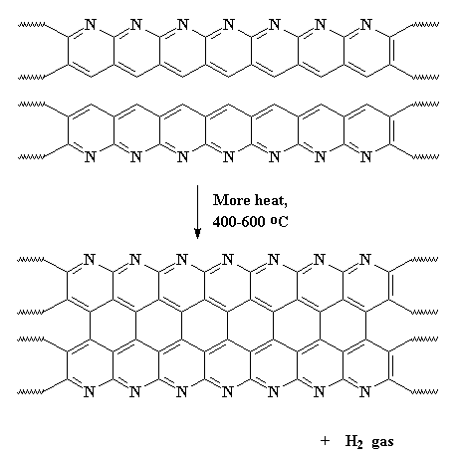
CARBON FIBER FORMATION CHEMISTRY
When the temperature increases from 600 up to 1300 ºC, the ribbons will themselves join together to form even wider ribbons like this:

Slide 34
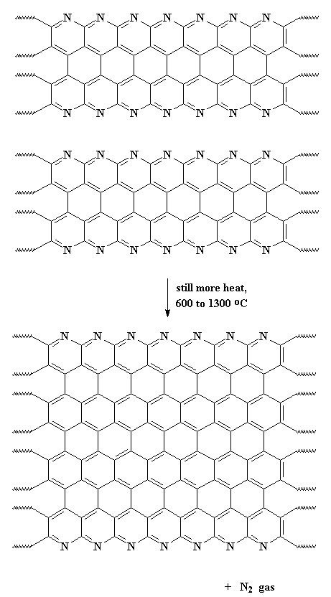
CARBON FIBER FORMATION CHEMISTRY
More nitrogen is expelled and the ribbons are really wide, and most of the nitrogen is gone, leaving us with ribbons that are almost pure carbon in the graphite form.

Slide 35
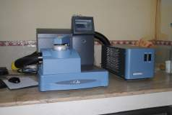
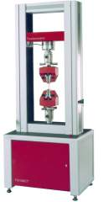
FIBER CHARACTERIZATION
XRD (X Ray Diffraction)
SEM (Scanning Electron Microscopy)
DSC (Differential Scanning Calorimeter)
TGA (Thermo Gravimetric Analyzer)
DMA (Dynamic Mechanical Analyzer)
UTM (Universal Testing Machine)

Slide 36
PAN FIBER GRADE
The Carbonization temperature will determine the grade of fiber produced:
Carbonization Temperature (ºC) | to 1000 | 1000 - 1500 | 1500 - 2000 | 2000 + (Graphitization)
Grade of Carbon Fiber | Low Modulus | Standard Modulus | Intermediate Modulus | High Modulus
Modulus of Elasticity (GPa) | to 200 | 200 - 250 | 250 - 325 | 325 +

Slide 37
CARBON FIBER GROUPING
FINAL HEAT TREATMENT TEMPERATURE
Type-I, high-heat-treatment carbon fibers (HTT)
Final heat treatment temperature > 2000°C and can be associated with high-modulus type fiber.
Type-II, intermediate-heat-treatment carbon fibers (IHT)
Final heat treatment temperature should be > = 1500°C and can be associated with high-strength type fiber.
Type-III, low-heat-treatment carbon fibers
Final heat treatment temperatures not greater than 1000°C. These are low modulus and low strength materials.

Slide 38
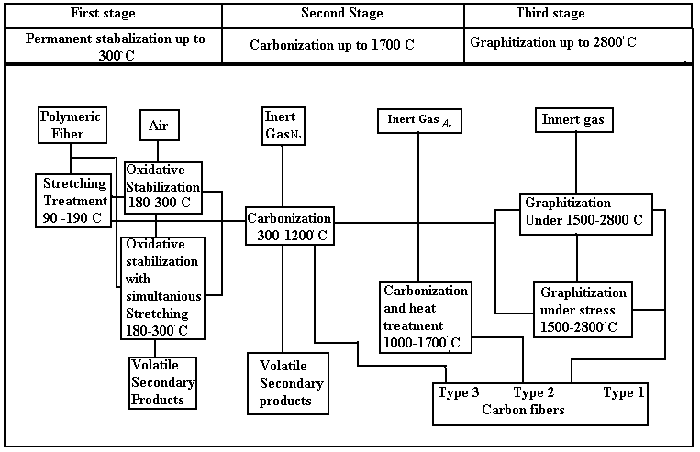
CARBON FIBER FORM PAN FIBER

Slide 39
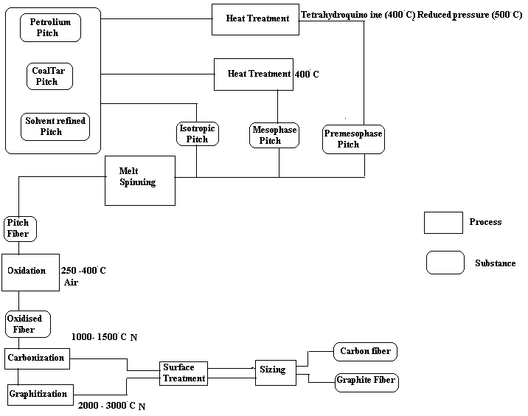
CARBON FIBER FROM PITCH

Slide 40
MECHANICAL PROPERTIES OF CARBON FIBER

