Slide 1
Reinforcement Materials & Other Ingredients

Slide 2
FILLERS
It is used to modify mechanical properties & to reduce the cost.
Use to make plastic, increase bulk or improve properties.
Effect of Fillers
The use of inert fillers can influence the polymer properties in the following ways :-
Increase in density.
Increase in modulus of elasticity.
Lower shrinkage.
Increase in hardness.
Increase in HDT.
Reduction of raw material cost.
For e.x. Calcium Carbonate, Clay, Talc etc..,

Slide 3
Reinforcement for Composites
There are two type of classification available in fillers.
1.Minerals (Calcium Carbonate, Clay, Talc )
2.Reinforcement Fibres(Glass Fibre, Carbon Fibre)
Reinforcement Fibres:
Used to reinforce or improve tensile strength, flexural strength and stiffness of the material.
Fibers - length/diameter >100

Slide 4
Fibre
Natural Fibres Synthetic Fibre
Ex:Cellulose,Jute,Coir etc.., Glass fibre, Carbon Fibre etc..,

Slide 5
Natural Fibre
Fibres commonly used in composites materials, carpet, ropes, coir and geo textile.
Natural fibres such as jute and coir have been computing the properties of cellulose fibres.
Cellulose fibres are obtained from different parts of vegetables plants for e.g. jute are obtained from the stem; sisal, banana and pineapple from leaf, cotton from seed, coir from fruit etc.

Slide 6
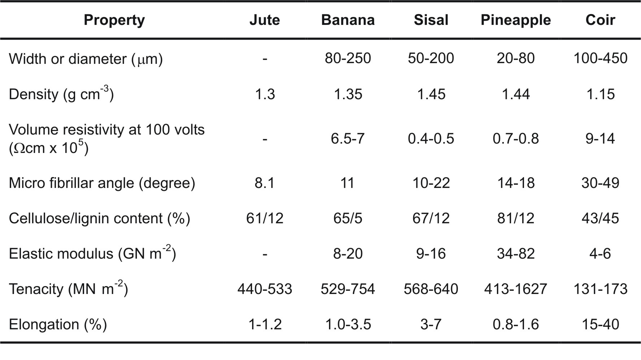
Properties of Fibres

Slide 7
ADVANTAGES OF NATURAL FIBRES
Advantages of Natural fibre composites for automotive components includes weight reduction of 10-30%, excellent absorption properties, good impact properties with convenience of forming complex shaped parts in a single moulding process.
Products such as car underbody coverings, interior door panels, dash & back panels, package trays, truck liners, door trims are being fabricated by natural fibre composites.
Natural fibre is a very potential candidate in making of composites, especially for partial replacement of high-cost glass fibres for low load bearing applications.
The glass provides strength & stiffness while natural fibre reduces the overall weight.
From the point of view of wood substitution, natural fibre composite boards could offer an excellent eco-friendly solution.
With ever-depleting forest reserves and premium on wood, a composite based on renewable resources such as jute, coir, sisal etc. is poised to penetrate the market.

Slide 8
CONTINUE….
Any value-added application avenues for these fibres would directly contribute to the economic benefits of their growers.
Indigenous wood supply for plywood industry having been stopped virtually and with increasing landed cost of imported plywood in India, the jute-coir composite boards provide very good value for the customers without any compromise in properties.
Value-added novel applications of natural fibre composites would not only go a long way in improving the quality of life of people engaged in jute cultivation, but would also ensure international market for cheaper substitution.

Slide 9
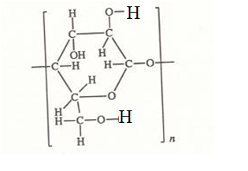
Cellulose
Cellulose is a natural polymer produced from wood via wood pulp.
Cellulose is the most abundant of naturally occurring organic compounds for, as the chief constituent of the cell walls of higher plants, it comprises at least one third of the vegetable matter of the world.

Slide 10
Continue….
The cellulose content of such vegetable matter varies from plant to plant. For example, oven-dried cotton contains about 90% cellulose, while an average wood has about 50%. The balance is composed of lignin, polysaccharides other than cellulose and minor amounts of resins, proteins and mineral matter.
In spite of its wide distribution in nature, cellulose for chemical purposes is derived commercially from only two sources, cotton linters and wood pulp.

Slide 11
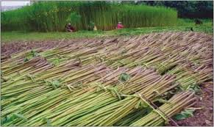
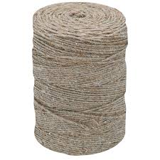
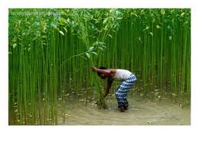
JUTE

Slide 12
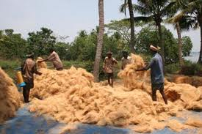
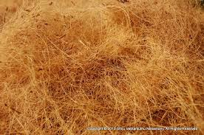
COIR

Slide 13
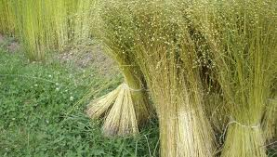
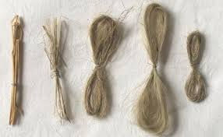
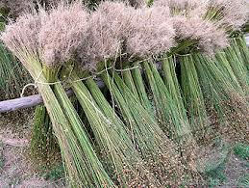
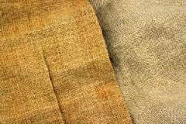
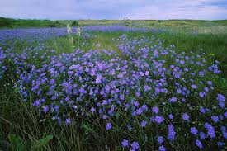
LINEN

Slide 14
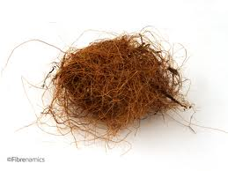
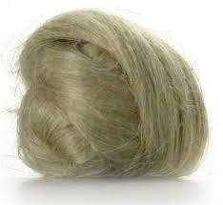
VEGETABLE FIBRE

Slide 15
JUTE,LINENE& VEGETABLE FIBRE
About 100 million people in the world are dependent on jute & Linen for their livelihood with a good number of women workers involved in various stages of production.
Main Strengths - High strength and modulus - Low extensibility - Moisture absorbing ability - High abrasion resistance - Good thermal stability - Insulation against sound - Anti-static property - Surface morphology

Slide 16
Additional advantages
Renewable
Unbreakable and Durable
UV-, termite-, acid- resistant
Less costly
Biodegradable
Eco-friendly etc.
APPLICATION
Shopping & Carry bags, Home textiles, Floor coverings ,Bio-composites,Technical/industrial,textiles,Geotextiles,Agrotextiles,Jute non-wovens,Pulp&paper,Particle boards,Fashion accessories,Handicrafts,Footwear

Slide 17
Synthetic Fibre
The Fibre which made by human is called synthetic fibres.
Ex:1.Glass fibre
2.carbon Fibre
3.Aramide Fibre etc..,

Slide 18
Glass Fibre:
The term "fiberglass" technically refers to glass that can be pulled into long, thin fibers although it is also commonly used in reference to plastics reinforced with these fibers.
Fiberglass is made primarily of silica but contains some percentage of other oxides that modify its properties for a particular application.
Common fiberglass modifiers are calcium oxide (CaO), magnesium oxide (MgO), aluminum oxide (Al2O3) and boric oxide (B2O3).
The chemical formula depends on the ratios of the different compounds used. For instance, a fiberglass produced by combining silica, boric oxide, magnesium oxide and aluminum oxide in a molecular ratio of 85:9:5:1 would have a molecular formula of Al2O3*9B2O3*5MgO*85SiO4.
Glass fibers used for reinforcing composites generally range in diameter from 0.00035” to 0.00090” (9 to 23 microns).
Glass is an inorganic polymer based on silicon.
Four oxygen atoms are arranged around the silicon atom in a form of tetrahedron.
No melting temperature.(It softens at 1713 °C.)

Slide 19
Glass Fiber types
A Glass
AR Glass
C Glass
E Glass
HS Glass
S Glass
A GLASS
A glass has alkali containing glass composition sometimes used for Fiber manufacturing. (It shows very significant strength diameter relationship)

Slide 20
AR Glass
AR glass is alkali resistant glass used in the form of fiber for reinforcement.
C Glass
C glass has a chemically resistant glass composition used for fiber manufacturing.
E Glass
E glass has an almost universally acceptable formulation and has become standard for most of the uses in fiber and related product. The letter E stands for electrical as the composition has a high electrical resistance.(E Glass is almost independent of its diameter)
HS Glass
HS glass is a magnesium-aluminasilica glass but contain small amounts of a number of other oxides - HS stands for high strength.
S Glass
S glass has a composition similar to HS glass which, in fiber form, possesses a high strength; the growth of this material in advanced composites is increasing rapidly.

Slide 21
GF-Manufacturing Method
Fibers are drawn at high speeds, approaching 200 miles per hour, through small holes in electrically heated bushings.
These bushings form the individual filaments. The filaments are gathered into groups or bundles called “strands.”
The filaments are attenuated from the bushing, water and air cooled, and then coated with a proprietary chemical binder or sizing to protect the filaments and enhance the composite laminate properties.
The sizing also determines the processing characteristics of the glass fiber and the conditions at the fiber-matrix interface in the composite.

Slide 23
Properties of Glass Fibre
Glass is generally a good impact resistant fiber but weighs more than carbon or aramid.
Glass fibers have excellent characteristics, equal to or better than steel in certain forms.
The lower modulus requires special design treatment where stiffness is critical.
Composites made from this material exhibit very good electrical and thermal insulation properties.
Glass fibers are also transparent to radio frequency radiation and are used in radar antenna applications.

Slide 24
APPLICATION
Noise abatement
good for places that fire is a problem
Fire protection
Temp control
Air purification
Insulation, roofing materials
filters
Safety glass and windows
Glass fiber reinforced circuit boards
Glass reinforce plastic
Glass as a rubber reinforcement
Mattress covers for hotels
Optical fibers

Slide 25
Carbon Fibers
Carbon fiber is created using polyacrylonitrile (PAN), pitch or rayon fiber precursors.
PAN based fibers offer good strength and modulus values up to 85-90 Msi.
They also offer excellent compression strength for structural applications up to 1000 ksi.
Pitch fibers are made from petroleum or coal tar pitch.
Pitch fibers extremely high modulus values (up to 140 Msi) and favorable coefficient of thermal expansion make them the material used in space/satellite applications.
Carbon fibers are more expensive than glass fibers, however carbon fibers offer an excellent combination of strength, low weight and high modulus. The tensile strength of carbon fiber is equal to glass while its modulus is about three to four times higher than glass.

Slide 26
Manufacturing
Carbon fibers are supplied in a number of different forms, from continuous filament tows to chopped fibers and mats.
The highest strength and modulus are obtained by using unidirectional continuous reinforcement.
Twist-free tows of continuous filament carbon contain 1,000 to 75,000 individual filaments, which can be woven or knitted into woven roving and hybrid fabrics with glass fibers and aramid fibers.

Slide 27
Properties
Carbon fiber composites are more brittle (less strain at break) than glass or aramid.
Carbon fibers can cause galvanic corrosion when used next to metals. A barrier material such as glass and resin is used to prevent this occurrence.

Slide 29
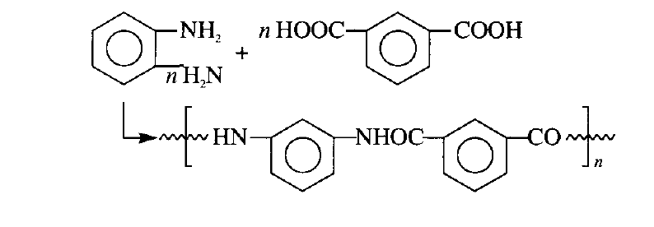
Aramid Fibers (Polyaramids
In recent years there has been considerable interest in aromatic polyamide fibres, better known as aramid fibres.
A manufactured fibre in which the fibre-forming substance is along chain synthetic polyamide in which at least 85% of the amide linkages are attached directly to two aromatic rings.
The first significant material of this type was introduced in the 1960s by DuPont as HT-1, later re-named Nomex; a poly-(m-phenyleneisophthalamide), it is prepared by condensation of 1,3-phenylenediamine with isophthalic acid

Slide 30
Continue….
In 1973 Du Pont commenced production of another aromatic polyamide fibre, a poly-(p-phenyleneterephthalamide) marketed as Kevlar.
Specifically, p-phenylenediamine is treated with terephthalyl chloride in a mixture of hexamethylphosphoramide and N-methylpyrrolidone (2: 1) at -10°C

Slide 31
Aramid Fibers (Polyaramids) Properties
Aramid fiber is an aromatic polyimide that is a man-made organic fiber for composite reinforcement.
Aramid fibers offer good mechanical properties at a low density with the added advantage of toughness or damage/impact resistance.
They are characterized as having reasonably high tensile strength, a medium modulus, and a very low density as compared to glass and carbon.
The tensile strength of aramid fibers are higher than glass fibers and the modulus is about fifty percent higher than glass.
These fibers increase the impact resistance of composites and provide products with higher tensile strengths.
Aramid fibers are insulators of both electricity and heat. They are resistant to organic solvents, fuels and lubricants.
Aramid composites are not as good in compressive strength as glass or carbon composites. Dry aramid fibers are tough and have been used as cables or ropes, and frequently used in ballistic applications.

Slide 32
Polymeric Fibre
Fibre made by polymer that is called polymeric fibre.
In certain substances thousands of units join together to form a large unit, called polymer (poly means many). Polymer is made of many repeating units.
The process of joining together monomers to form a polymer is called polymerization.
Example for Polymeric Fibre:
Rayon
Nylon
Polyester

Slide 33
Rayon
Rayon is prepared from cellulose. Though cellulose is a natural polymer it needs extensive chemical treatment to form rayon. Hence it is also considered as a semi-synthetic fibre.
Advantage of rayon :
it is cheaper to produce as compared to cotton itself since waste cotton and paper is used for making rayon.
Secondly, rayon can be blended with other fibres like wool and silk.

Slide 34
Nylon
Chemically it is a ‘polyamide’, a polymer. It is the strongest synthetic plastic material which can be moulded to any shape. Nylon has many uses as fibre, as sheet and as moulded solids.
Polyester
Alcohol and organic acid react together to make compounds called esters which are polymers. These are therefore called polyesters. If different alcohols and acids are used, different kinds of polyesters are made. Polyesters come under the brand names of ‘Terylene’, ‘Dacron’, ‘Terene’ and ‘Polyester’. Esters are compounds with fruity odour .

Slide 35
Properties
Rayon:
good absorbent of sweat
easily dyed and woven into cloth
drapes well
Nylon
toughest elastic material
high tensile strength
slightly water absorbent, dries quickly
Polyester
tough, light weight and elastic
resistant to pests and chemicals
dries quickly

Slide 36
Application
Rayon:
Mixed with fibre glass for making helmets
Reinforcing nylon tyres
Dress material because it is soft, silky and moisture absorbent
Nylon
Swimming wears, ropes, raincoats, seatbelts
Fishing nets and fishing lines
Polyester
Highly suitable for shirting, suiting, sarees and draperies
Mixed with fibre glass for moulding it into helmets, protective sheets and hulls in boats

Slide 37
Metallic Fibre
Metallic fibers are composed of metal. Plastic coated metal, metal coated plastic or a film completely rounded by a metal.
Metallic fibers are primarily used as fashionable lively effects in many textile fabrications as e.g hand made embroidery tufted rugs etc.
Gold and silver are used for ancient times for the purpose of fabric decorations as yarns.

Slide 39
PROPERTIES
Metals are generally crystalline in nature and under very cool and rapid conditions they produced amorphous metals.
It should also be avoid from heating because iron melts on heating easily which results in damaging of whole fiber.
The structure of metallic fibers is hard, having minimum elasticity.
little advantage to stiffness and strength..
Gains in toughness, wear resistance, reduced thermal distortion.

Slide 40
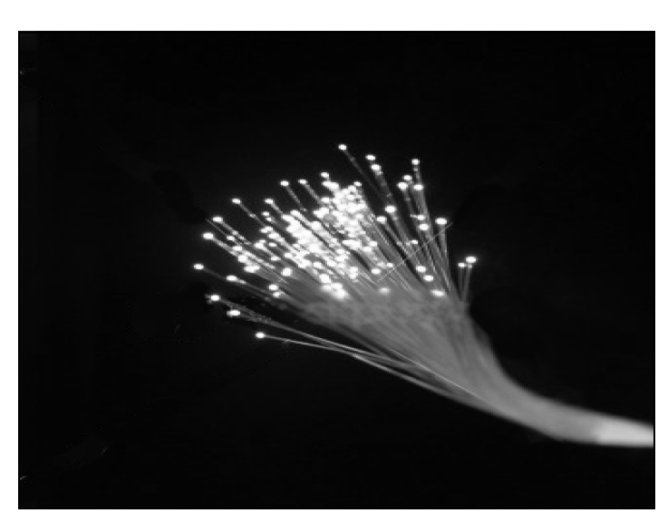
APPLICATION
Boron-fibre/aluminium used in aerospace.
Stainless steel and other metals fibers are also used for communication purposes in the form of telephone lines and television cables lines.
They are also used in missile nose.

Slide 41
Lubricants or Flow Promoters
Functions :-
To reduce friction between the material and the processing equipment. ( Adhesive forces)
To reduce heat & wear between two surfaces either between the polymer molecules or between the polymeric material and the equipment.
Reduces thermal degradation of the polymer.
Modifies flow characteristics.
Homogenous the polymer melt with other polymer additives.
To prevent the plastic from sticking to the mould surface during processing.
TYPES:
External Lubricants(Metal Stearates, Zinc Stearates)
Internal Lubricants(Amine Waxes, Ester Derivatives )

Slide 42
Plasticizers or softeners
Improve process ability by reducing T_{g.}
These are high boiling non-volatile solvents..
Reduce internal friction between polymer chain.
Effect of Plasticizers
Easy melt
Improve flexibility
Increase Softness and Flexibility.
Improve Process ability.
TYPES:
Primary(Phthalates – Di-Octyl Phthalate (DOP)
Secondary(Adipic Acid Polyesters)

Slide 43
Coupling Agents
These are used to increase the adhesion between polymer & filler, fiber by covalent bonds.
Ex:
Methacrylato-chromo chloride used for glass fibres & Polyester resin
Organosilanes are used for PVC , ABS and PA

Slide 44
Nanoscale Fillers
Nanoscale fillers come in many shapes and sizes. For ease of discussion, we have grouped nanofillers into three categories.
1.Fiber or tube fillers have a diameter <100 nm and an aspect ratio of at least 100. The aspect ratios can be as high as 106 (carbon nanotubes).
2.Plate-like nanofillers are layered materials typically with a thickness on the order of 1 nm, but with an aspect ratio in the other two dimensions of at least 25.
3.Three dimensional (3D) nanofillers are relatively equi-axed particles <100 nm in their largest dimension.
Ex: Carbon nanotubes, carbon black, pyrogenic silica and
diatomite

